Slide 1
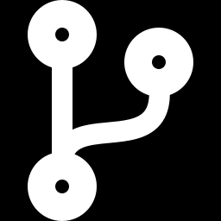
Getting Started with GitHub
Create your account, your first repository, upload a C++ program and make 5 commits
Worked example account
github.com/L1F24BSCS0081
Notes:
Introduce the assignment. Everything in this deck uses the dummy registration number L1F24BSCS0081 as a worked example; each student replaces it with their own UCP registration number.

Slide 2
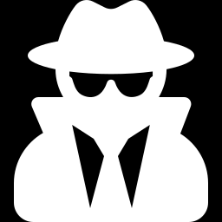
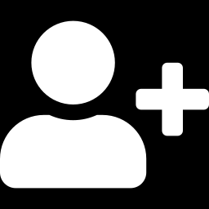
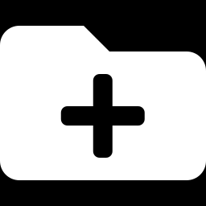
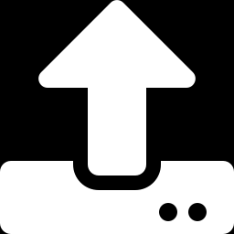
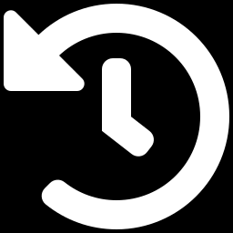
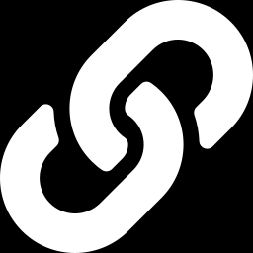
Today's lab at a glance
1. Open Incognito
2. Create account
3. Create repository
Start in a private browser window so no one else's GitHub login interferes.
Username = your UCP Reg No, e.g. L1F24BSCS0081
One public repo named Assignment01-GitHub-Basics with a README.
4. Upload .cpp file
5. Make 5+ commits
6. Share & submit
Upload your program with a clear, proper file name.
Improve the code and README step by step — each save is a commit.
Invite the instructor, then upload your PDF on the portal.
Notes:
Overview of the six things students will complete. Step 1 (Incognito) is highlighted in orange because skipping it is the most common cause of problems in shared labs.

Slide 3
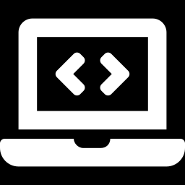
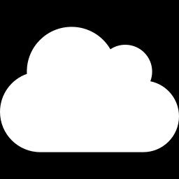
Git vs GitHub — and two words you must know
Repository (repo)
A project folder on GitHub that holds your files and their complete change history.
Git
GitHub
Example: L1F24BSCS0081/Assignment01-GitHub-Basics
A version-control tool. It records every change you make to your files, so you can see history and go back.
A website that stores Git repositories online, so you can share code, back it up and show your work.
Commit
A saved snapshot of your changes, with a message that explains what changed and why.
Example: “Add header comments with name and reg no”

Slide 4
Before you start: checklist & naming rules
Have these ready
Item | Use exactly | Why
Username | L1F24BSCS0081 | Instructor can identify you
Repository | Assignment01-GitHub-Basics | No spaces; hyphens are fine
C++ file | sum_of_first_50_ natural_numbers.cpp | Describes the program; ends in .cpp
Visibility | Public | Instructor can open the link
1
An email address you can open right now (you will receive an 8-digit code).
2
Your UCP registration number written correctly, e.g. L1F24BSCS0081.
3
A strong password you will remember — write it somewhere safe.
4
Your C++ file saved on the lab PC, e.g. on the Desktop, named sum_of_first_50_natural_numbers.cpp
Avoid names like “new.cpp”, “my code final (2).cpp” or “untitled.cpp”.

Slide 5
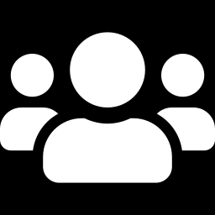

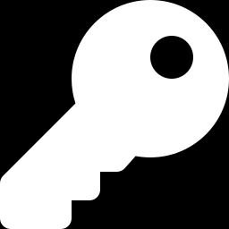
STEP 1
Why use an Incognito (private) window?
The problem on shared lab computers
How Incognito fixes it
A previous student may still be logged in to GitHub on the same browser.
Starts with no saved logins or cookies — a clean GitHub sign-up page.
Nothing you sign into is remembered after you close all Incognito windows.
Your GitHub account and repository are saved online — you lose nothing.
You might create a repository or commit inside someone else's account by mistake.
The browser may autofill another person's email or password.
Notes:
Stress: Incognito protects both the student and the next person who sits at the PC. It does not hide activity from the university network — it only stops the browser from keeping logins.

Slide 6
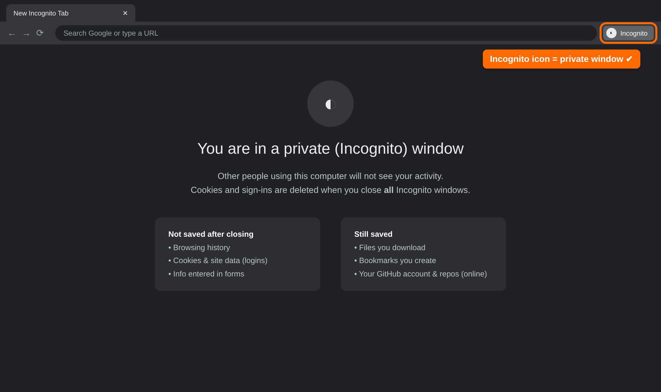
STEP 1
Open a private window before anything else
Browser | Shortcut
Chrome (Incognito) | Ctrl + Shift + N
Edge (InPrivate) | Ctrl + Shift + N
Firefox (Private) | Ctrl + Shift + P
Mac Chrome / Safari | ⌘ + Shift + N
Or: click the ⋮ / … menu at the top-right → “New Incognito / InPrivate / Private window”.
Check: you should see the dark window and the Incognito label next to the address bar.
Illustrative mock-up — the real GitHub screens may look slightly different.

Slide 7
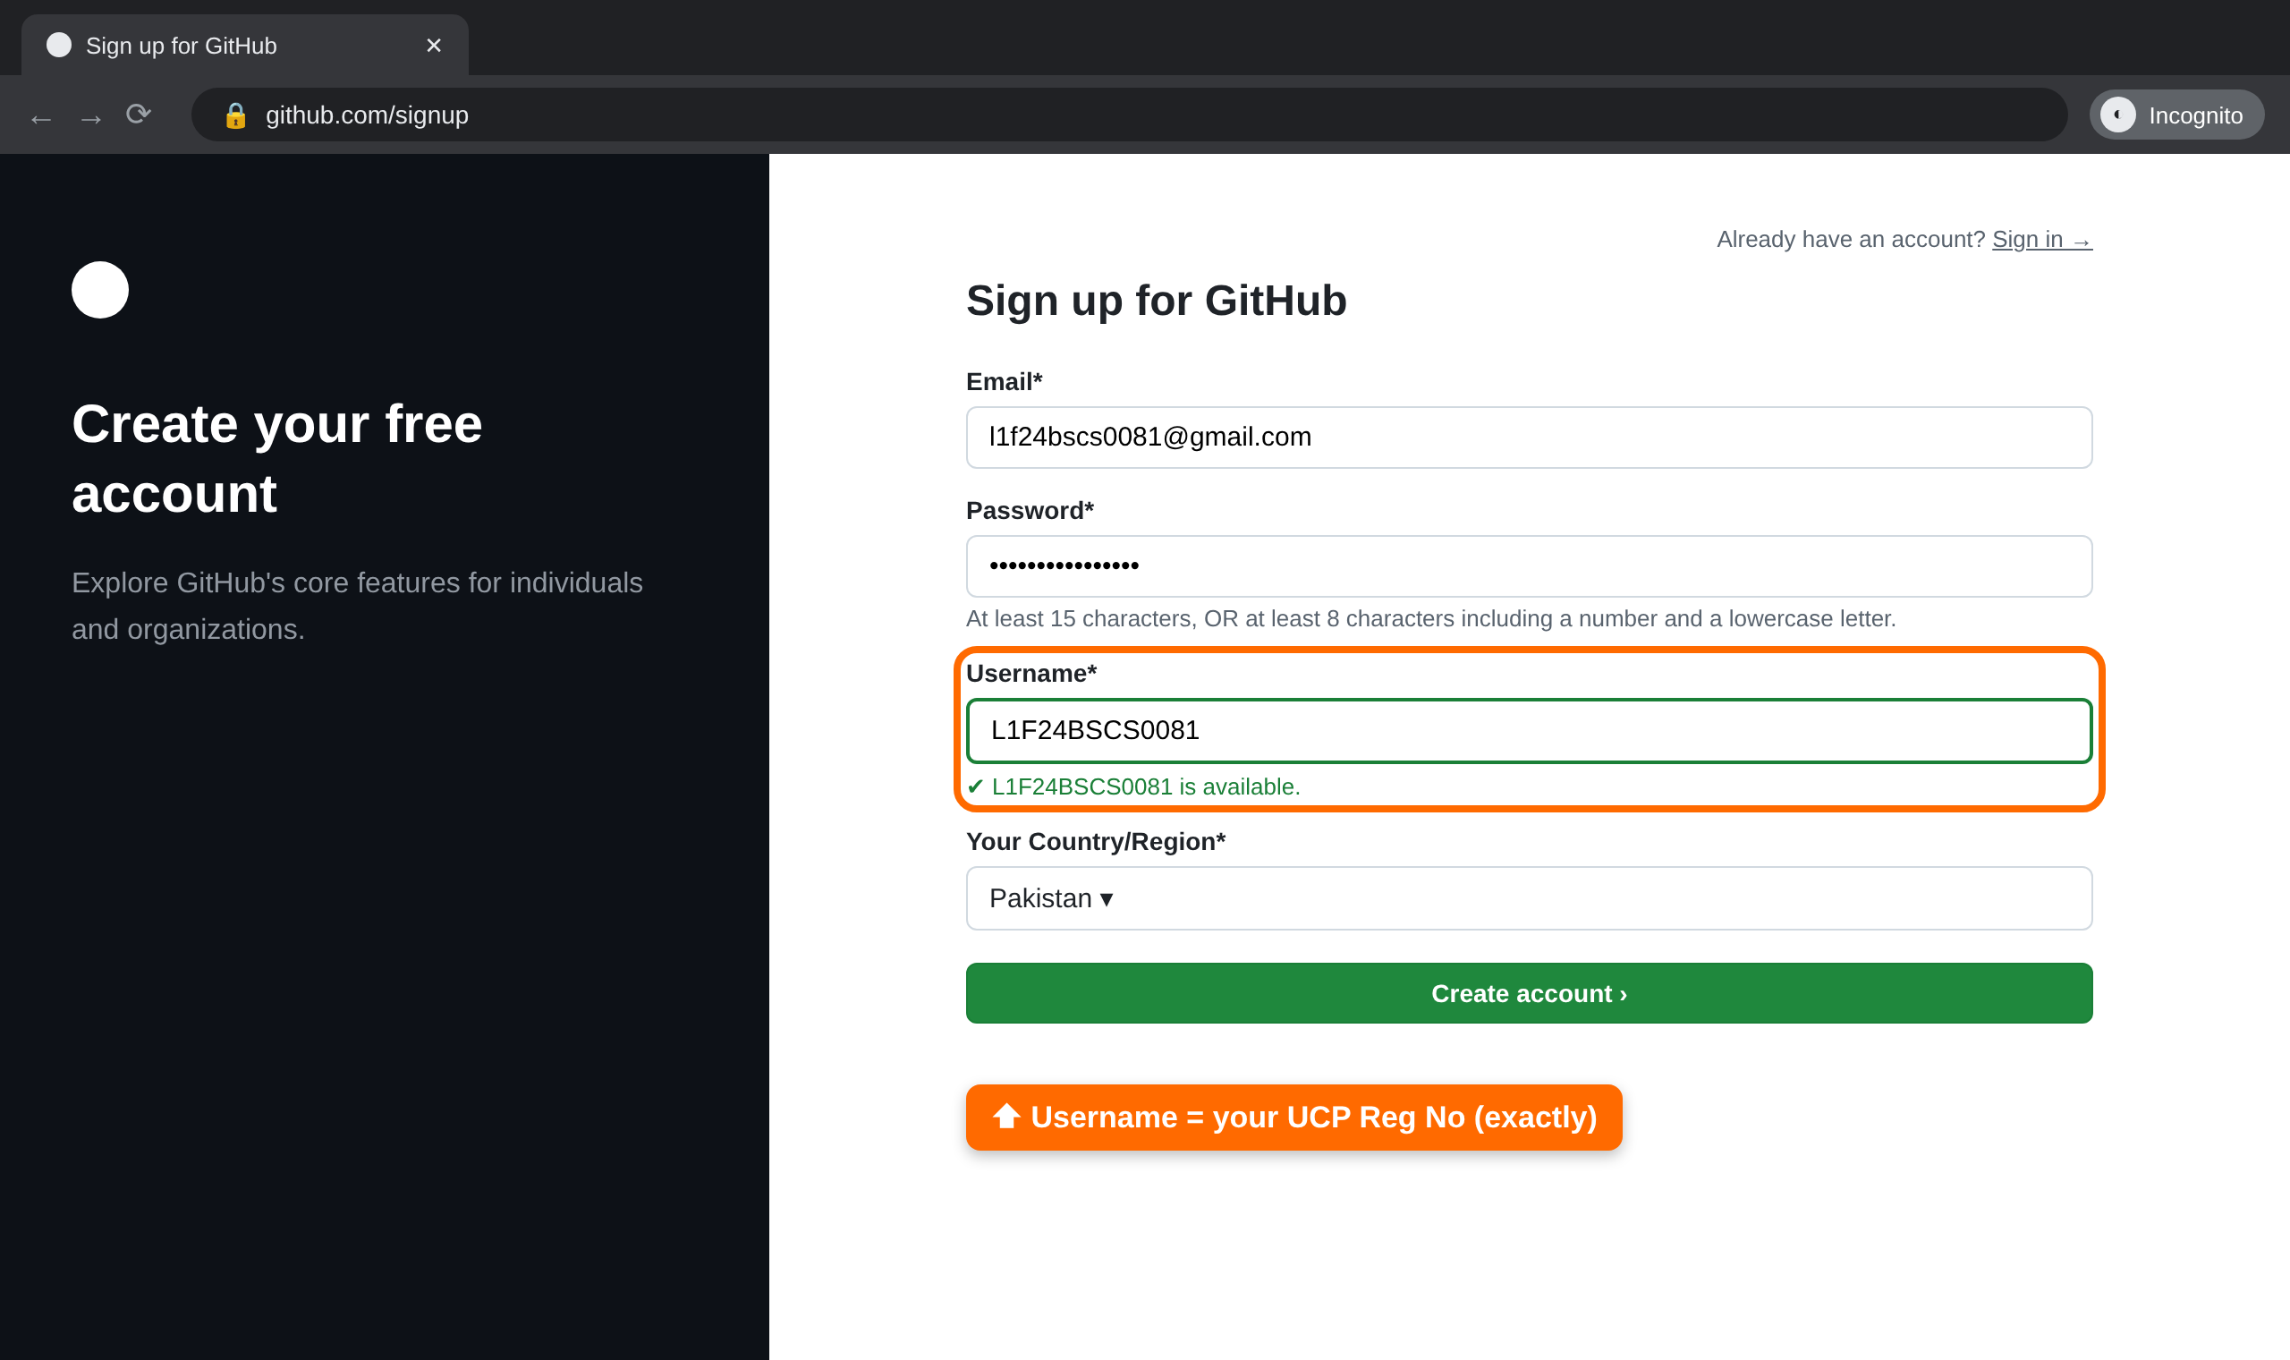
STEP 2
Create your GitHub account
1
In the Incognito window go to github.com/signup
2
Enter an email you can open now, and a strong password.
3
Username: type your Reg No exactly — L1F24BSCS0081. Wait for the green “available” tick.
4
Select Pakistan as your country, then click Create account.
Illustrative mock-up — the real GitHub screens may look slightly different.

Slide 8


STEP 2
Username rules — get it right the first time
Correct
Wrong
L1F24BSCS0081
Exactly as on your student card
L1F24-BSCS-0081
Extra hyphens added
l1f24bscs0081
Also fine — GitHub usernames are not case-sensitive
L1F24BSCS81
Digits missing
One account
One account per student, reused all semester
ali_L1F24BSCS0081
Name added; underscores are not allowed
cooldev2006
Instructor cannot identify you
Notes:
GitHub usernames may only contain letters, numbers and single hyphens. If a student's Reg No shows as already taken, they should inform the instructor rather than inventing a different name.

Slide 9
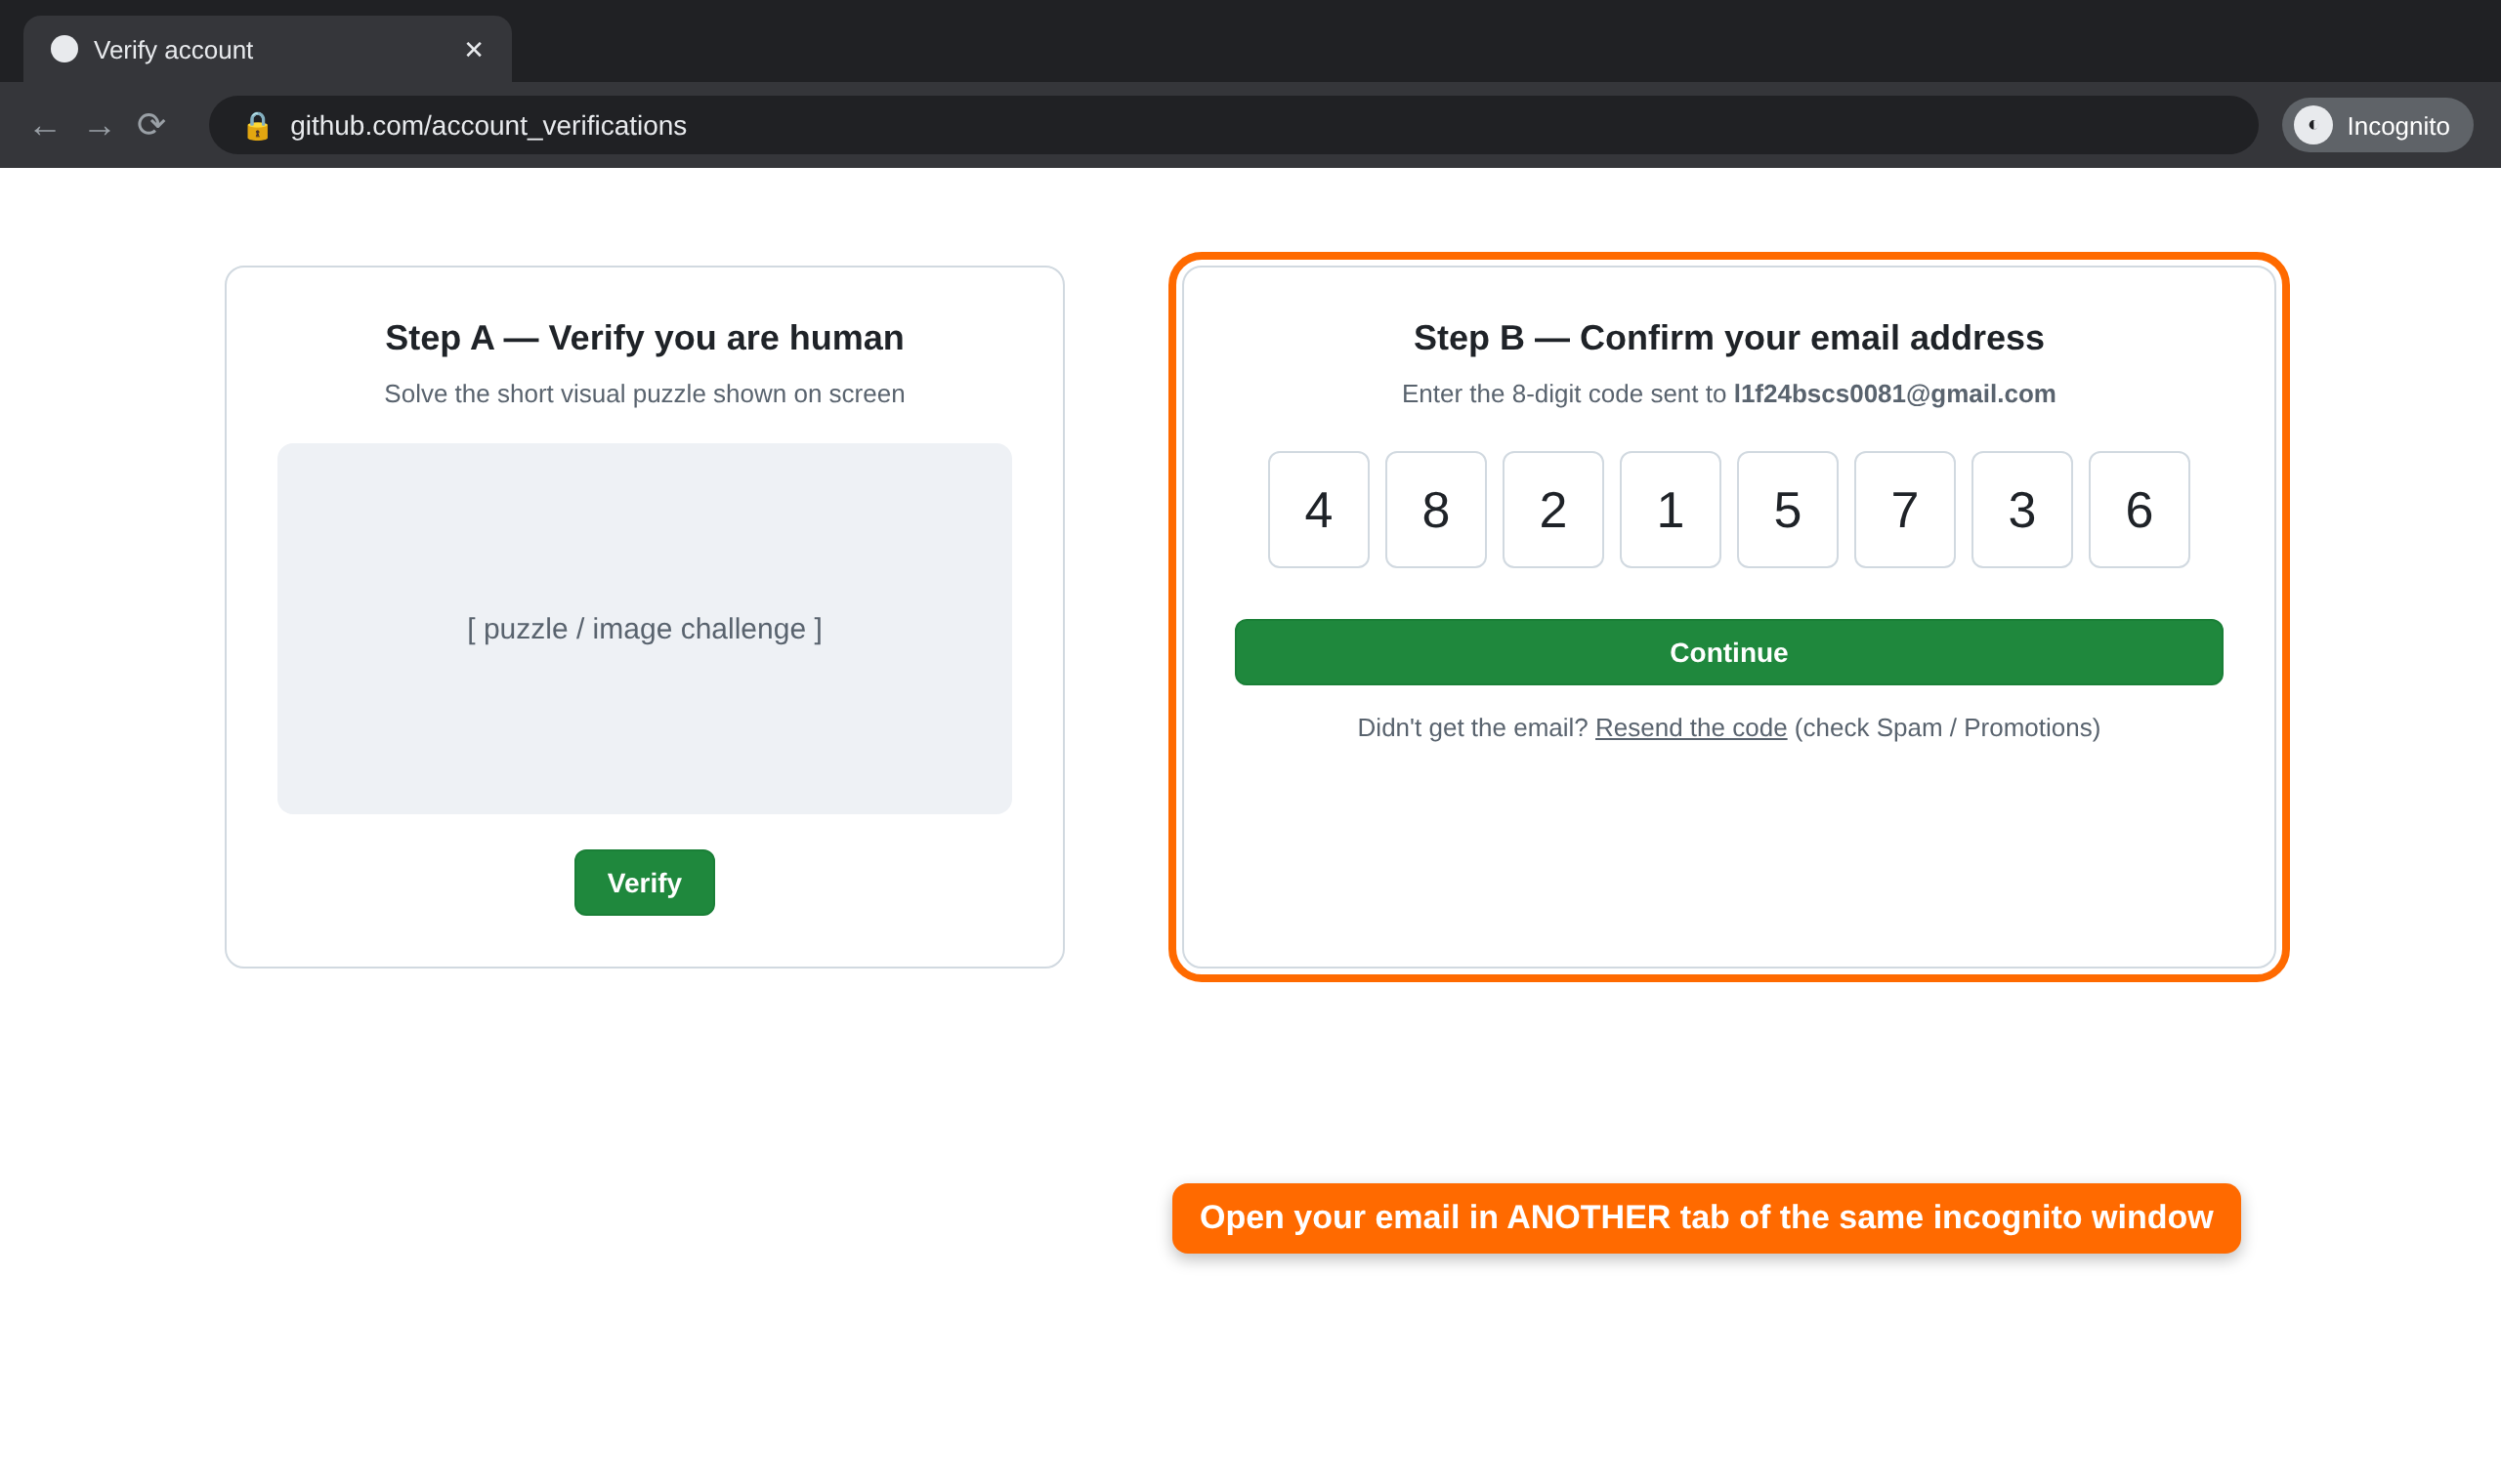
STEP 3
Verify you are human and confirm your email
1
Solve the short visual puzzle GitHub shows you.
2
Open your email in a new tab of the same Incognito window (Ctrl + T).
3
Copy the 8-digit launch code from GitHub's email and enter it.
4
No email after 2 minutes? Check Spam / Promotions, or click Resend.
Illustrative mock-up — the real GitHub screens may look slightly different.
Notes:
After the code is accepted GitHub may ask a few optional personalisation questions — students can skip them. They then land on their dashboard.

Slide 10
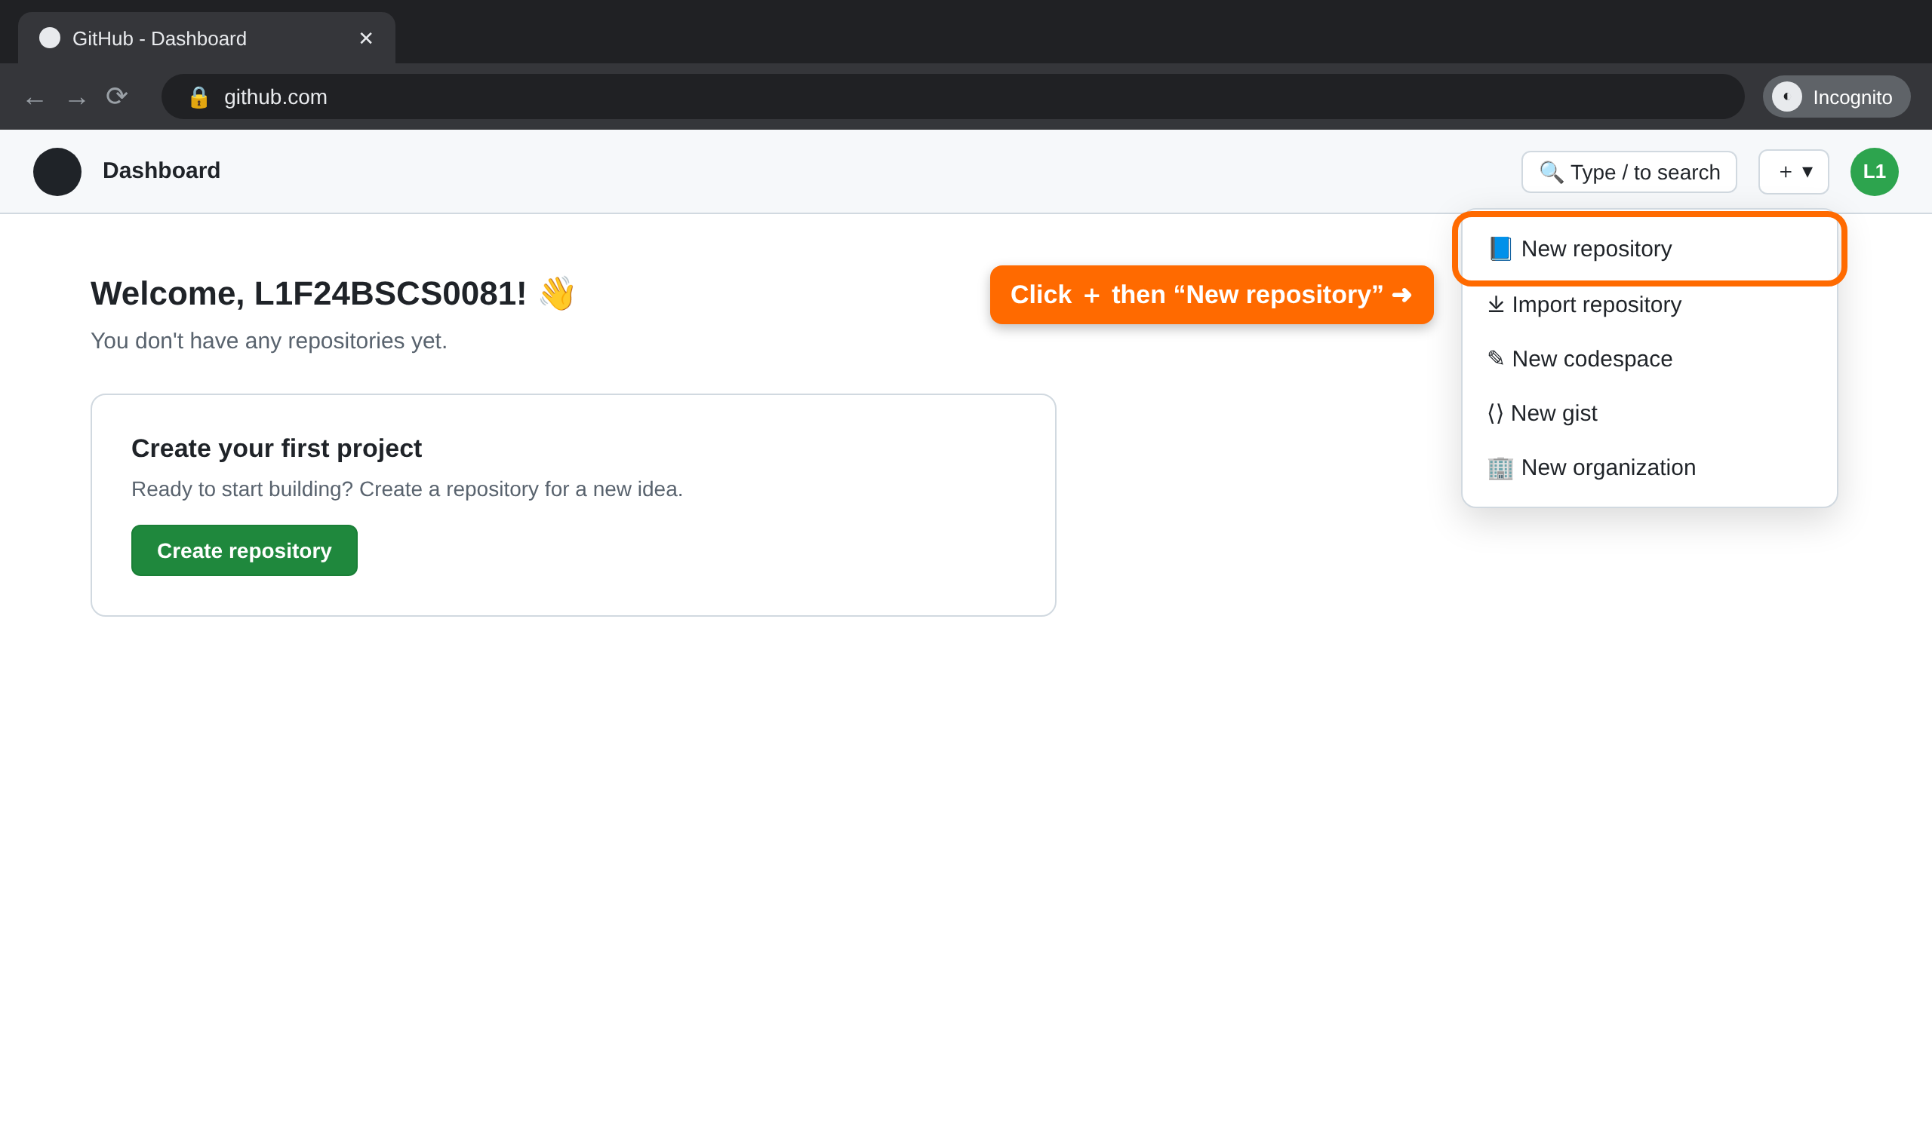
STEP 4
Start a new repository
1
Make sure the avatar at the top-right is YOUR account.
2
Click the ＋ button next to your avatar.
3
Choose “New repository” (or the green Create repository button on the dashboard).
Illustrative mock-up — the real GitHub screens may look slightly different.

Slide 11
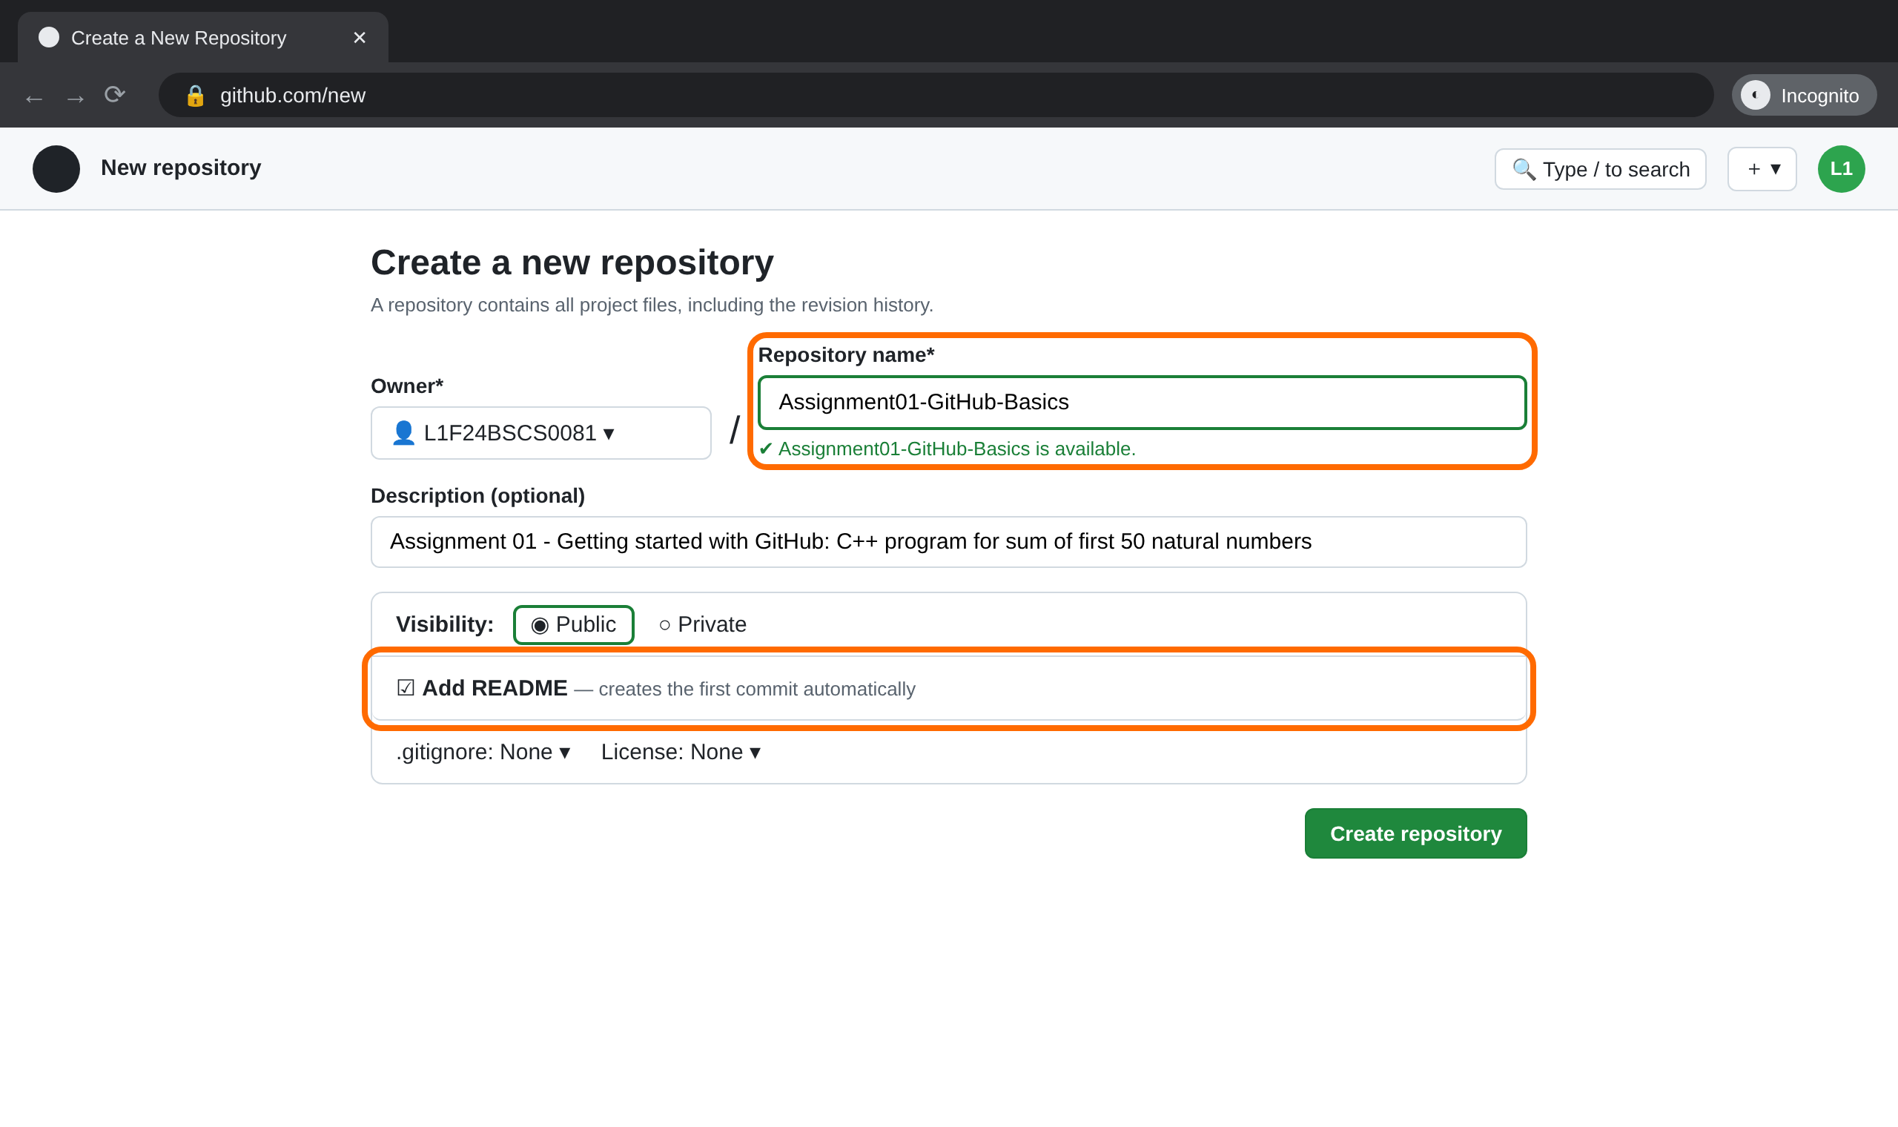
STEP 4
Fill in the repository details
1
Repository name: Assignment01-GitHub-Basics
2
Description: one line about the assignment (optional but good practice).
3
Visibility: Public, so the instructor can open it.
4
Turn ON “Add README” — this creates Commit #1 automatically. Then click Create repository.
Illustrative mock-up — the real GitHub screens may look slightly different.

Slide 12
The sample program you will upload
/*
* Program : Sum of First 50 Natural Numbers
* Name : Student Name
* Reg No : L1F24BSCS0081
* Assignment : 01 - Getting Started with GitHub
*/
#include <iostream>
using namespace std;
int main() {
const int N = 50;
int sum = 0;
// Method 1: add numbers one by one using a loop
for (int i = 1; i <= N; i++) {
sum += i;
}
cout << "Sum of first " << N << " natural numbers (loop): " << sum << endl;
// Method 2: verify using the formula n(n+1)/2
int formulaSum = N * (N + 1) / 2;
cout << "Sum using formula n(n+1)/2: " << formulaSum << endl;
return 0;
}
File name
sum_of_first_50_natural_numbers.cpp
Expected output
Sum of first 50 natural numbers (loop): 1275
Sum using formula n(n+1)/2: 1275
Tip
First upload a simple loop-only version. The header comments and formula check are added later as separate commits — that is how you reach 5 commits honestly.
Notes:
This is the final version of the file after all commits. The very first upload (commit 2) contains only the #include lines, main(), the loop and the cout statement.

Slide 13
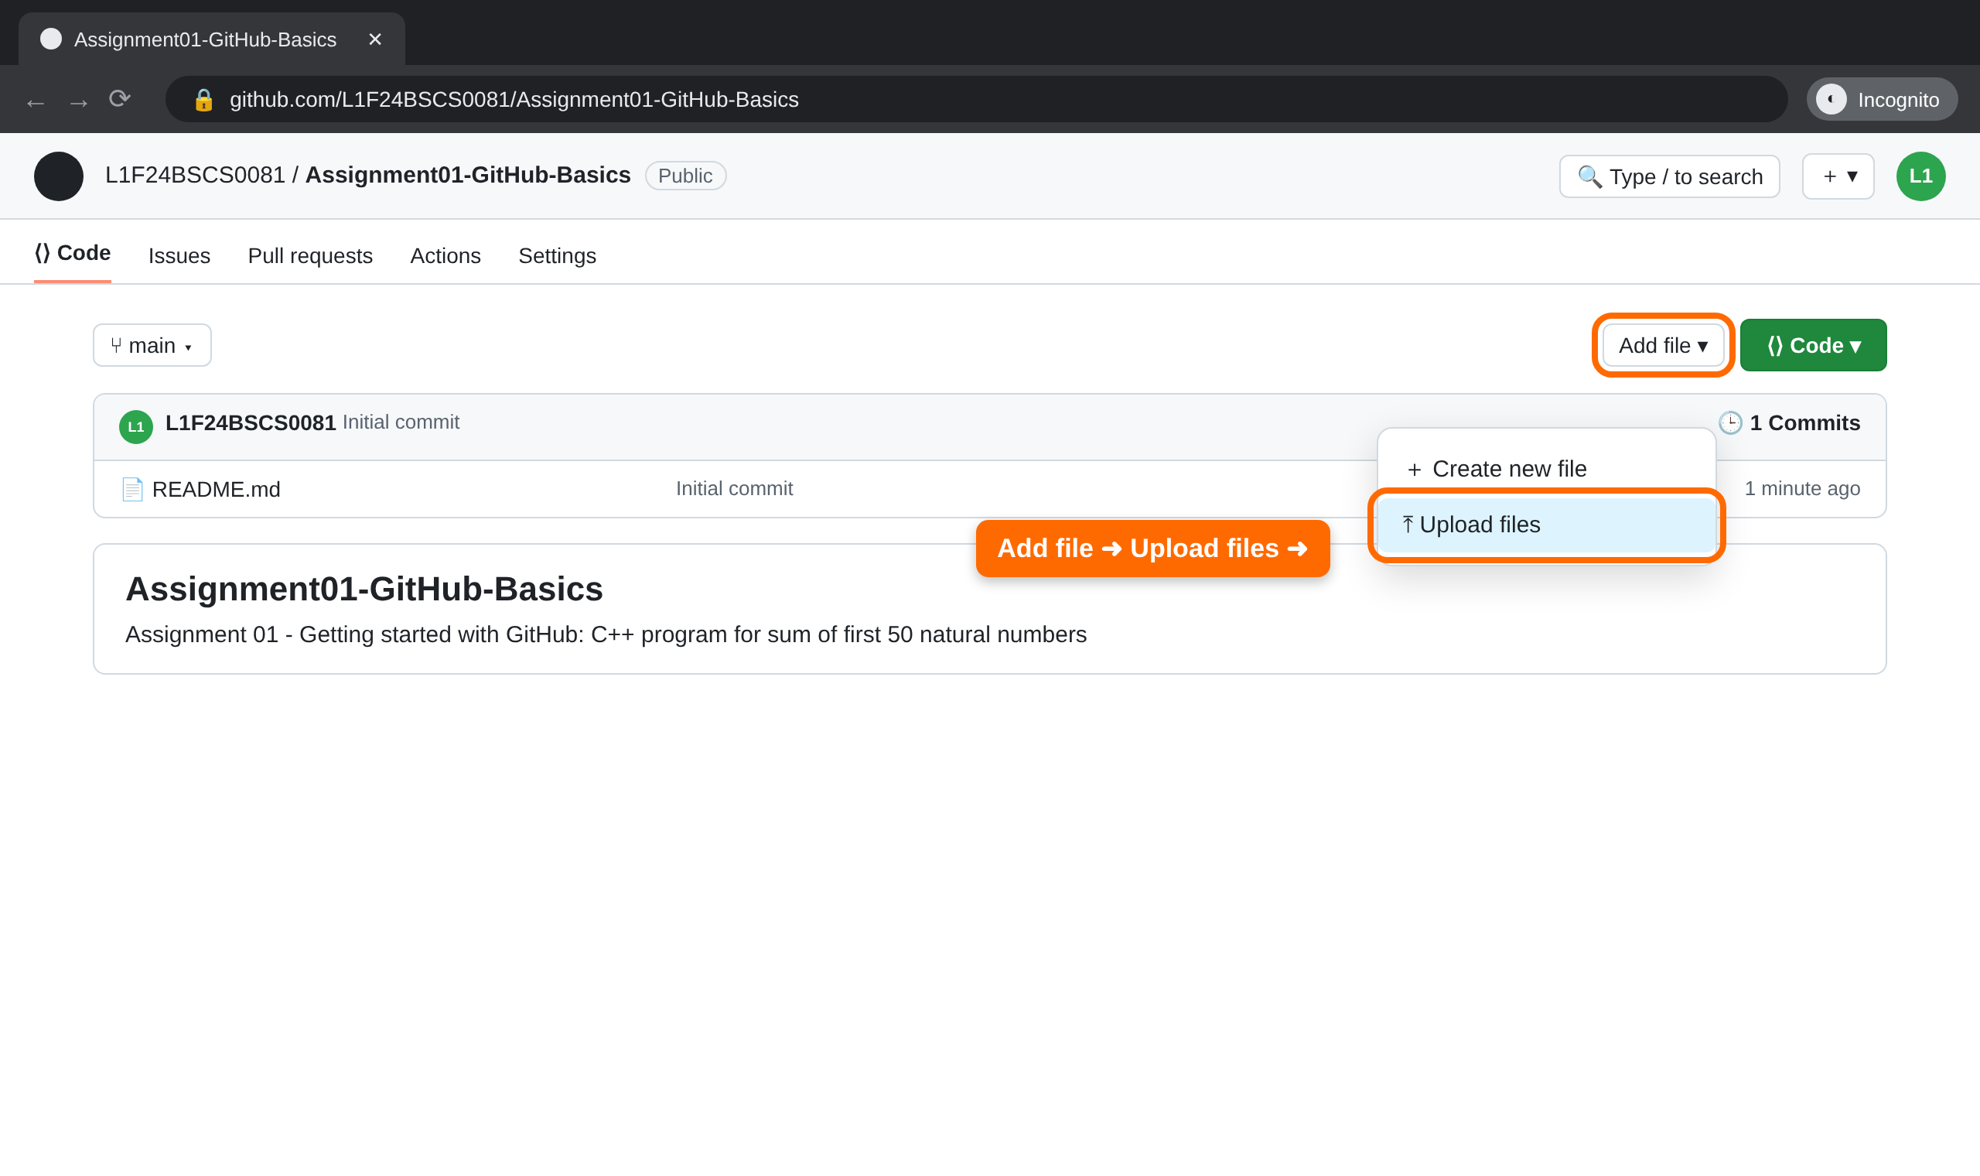
STEP 5
Open the upload page
1
You are now on your repository page — note “1 Commit” (the README).
2
Click Add file.
3
Choose Upload files.
Illustrative mock-up — the real GitHub screens may look slightly different.

Slide 14
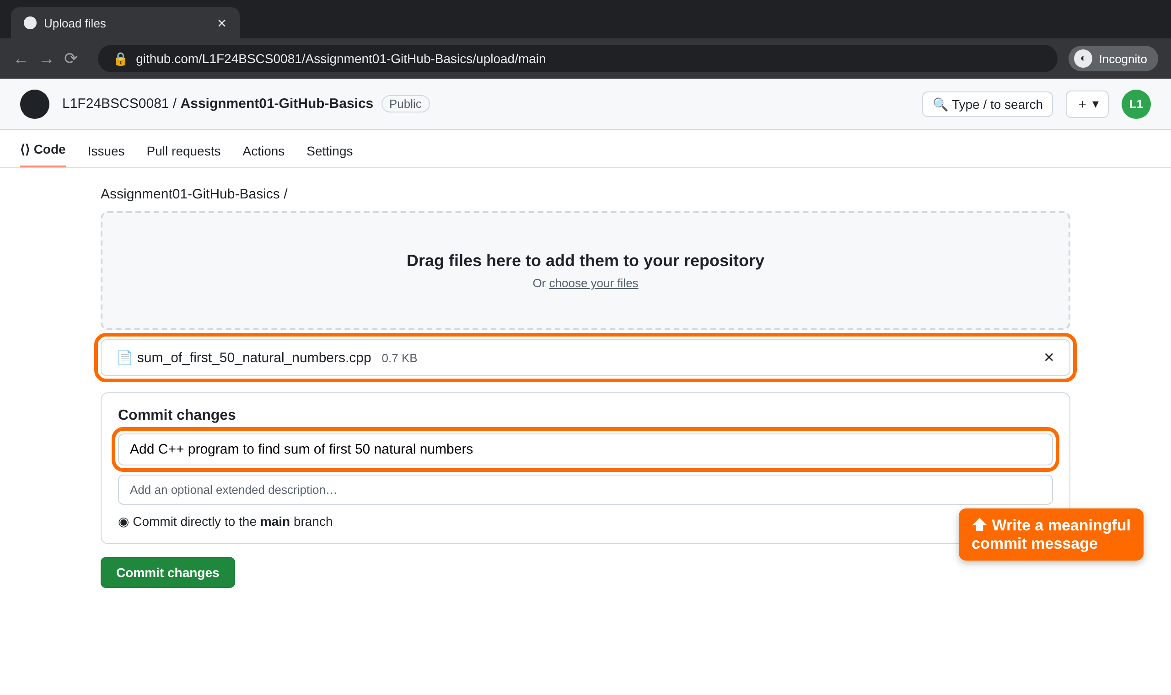
STEP 5
Upload your .cpp file and commit
1
Drag the .cpp file from the Desktop into the box, or click “choose your files”.
2
Check the file name is correct before committing.
3
Commit message: Add C++ program to find sum of first 50 natural numbers
4
Click Commit changes — this is Commit #2.
Illustrative mock-up — the real GitHub screens may look slightly different.

Slide 15
Writing good commit messages
A commit message tells your future self and your teacher what changed. Start with a verb and keep it short and specific.
Good
Avoid
Add loop to sum first 50 numbers
update
Add header comments with reg no
asdf
Fix off-by-one error in loop
final final 2
Update README with output
changes

Slide 16
Your 5 commits — the plan
1
Initial commit
README.md
Created automatically when you tick “Add README”.
2
Add C++ program to find sum of first 50 natural numbers
Upload
Upload the simple loop version of the .cpp file.
3
Add header comments with name and reg no
Edit .cpp
Edit the .cpp: add the /* … */ block at the top.
4
Add formula-based verification n(n+1)/2
Edit .cpp
Edit the .cpp: add Method 2 using the formula.
5
Update README with program description and output
Edit README
Edit README.md: describe the program and paste the output.
Notes:
Five is the minimum. Students who finish early can add more commits, e.g. taking N as input from the user or adding a sample_output.txt file with Add file > Create new file.

Slide 17
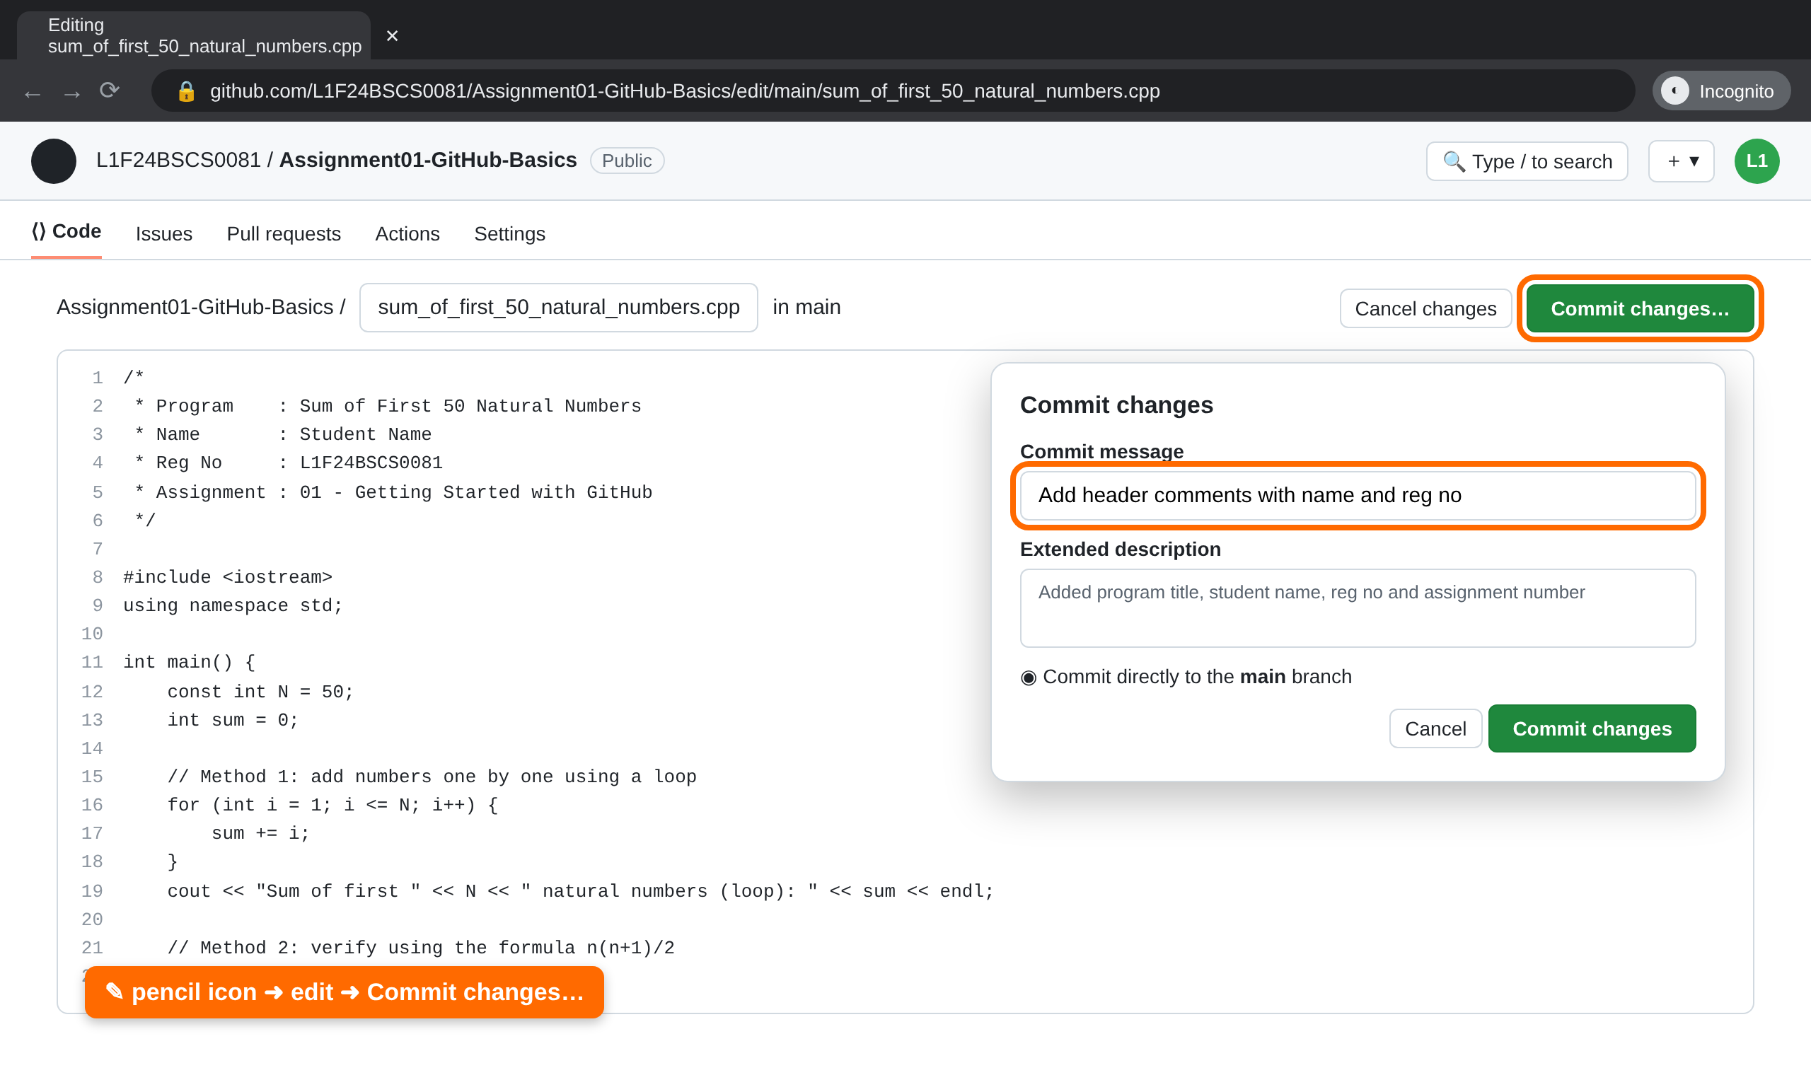
STEP 6
Edit a file on GitHub and commit
1
Click the file name, then the ✎ pencil (Edit) icon.
2
Make one change from the plan, e.g. add the header comment block.
3
Click Commit changes…, write the message, click Commit changes.
4
Repeat for commits #4 and #5 (formula, then README).
Illustrative mock-up — the real GitHub screens may look slightly different.

Slide 18
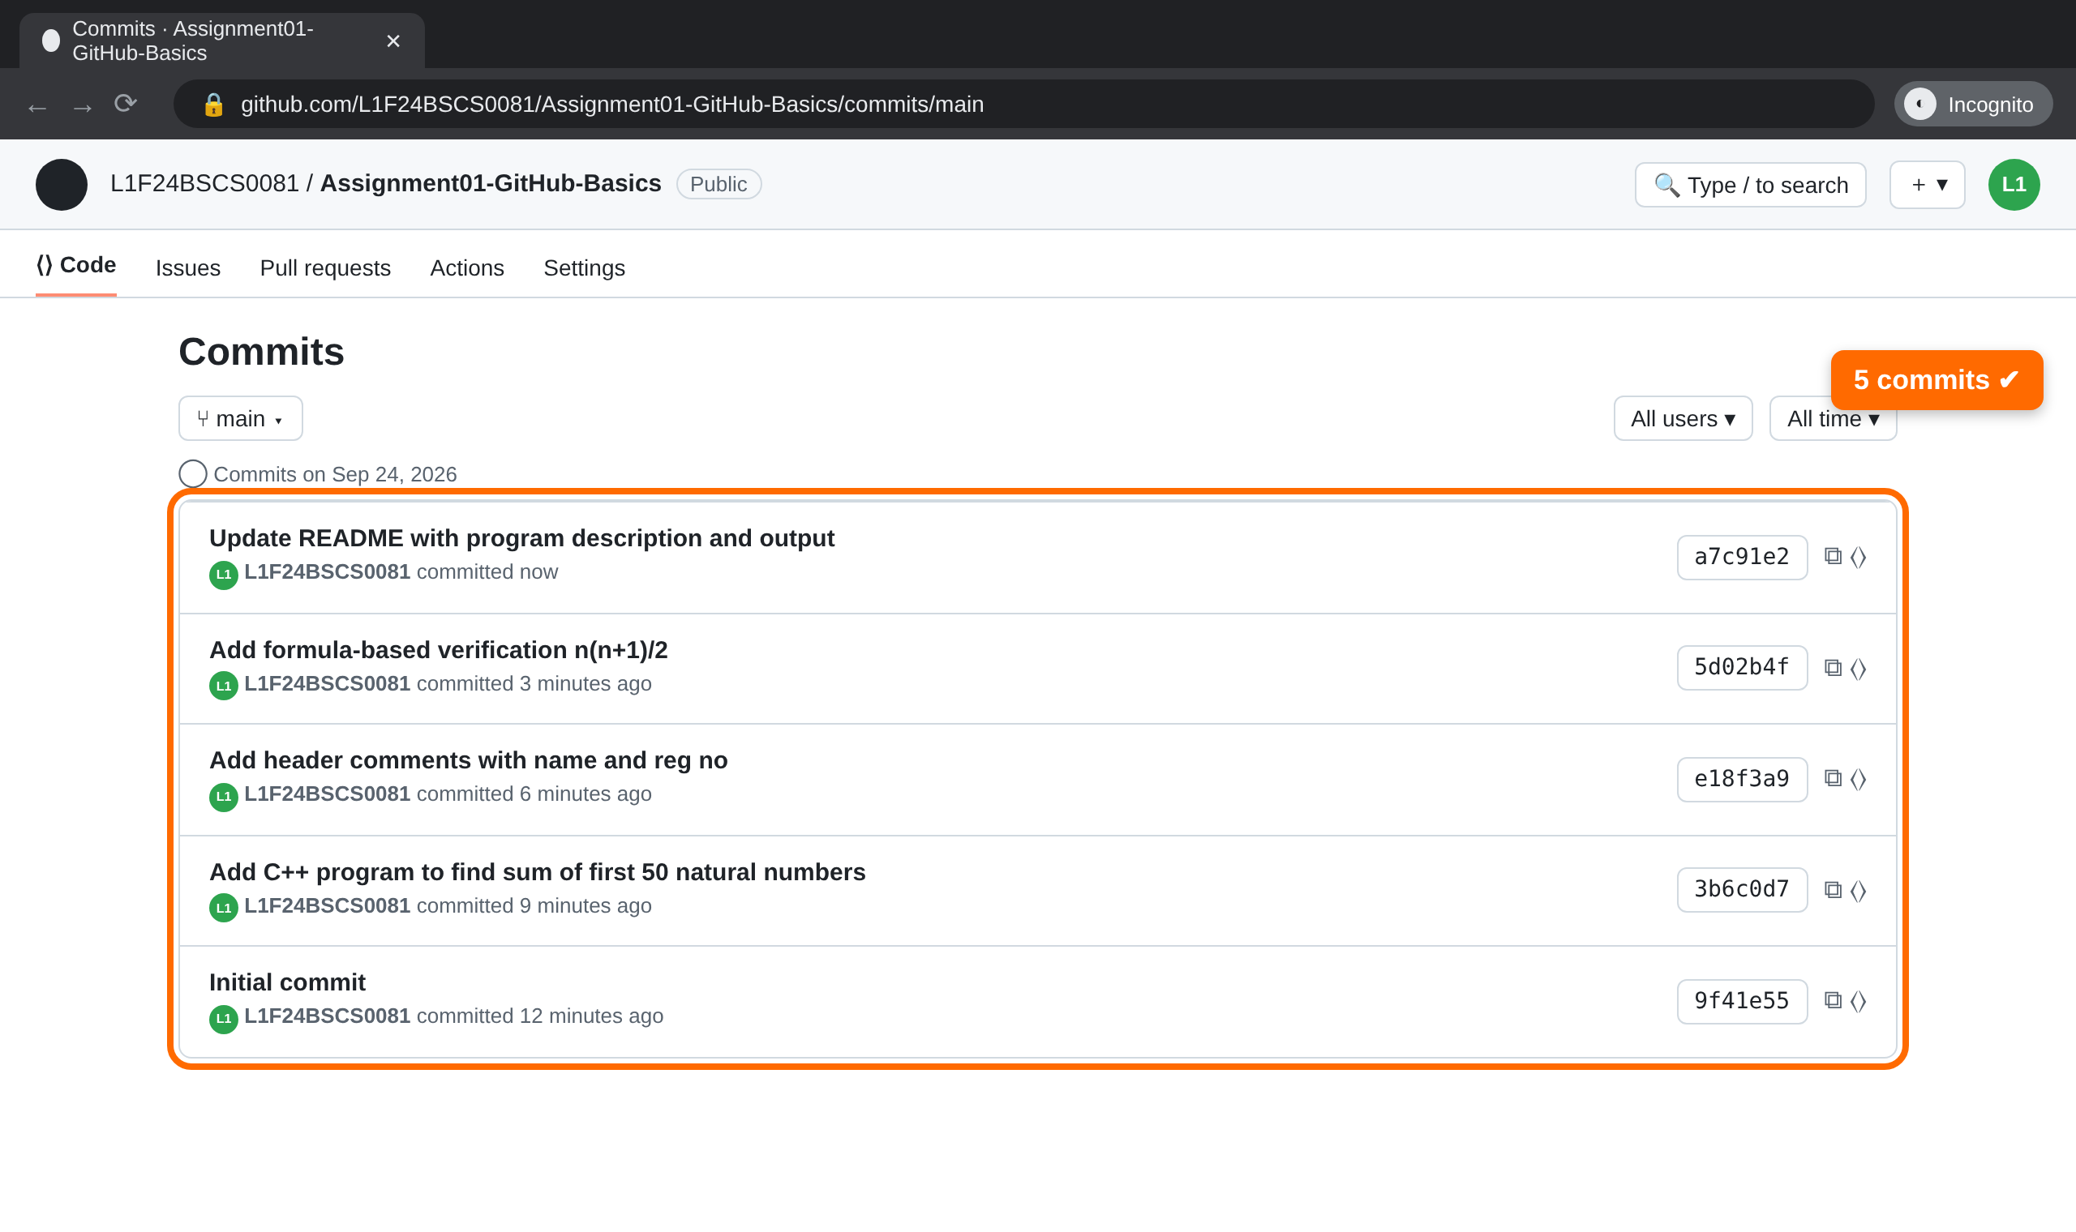
STEP 7
Check your commit history
1
On the repository page click the “Commits” count (clock icon).
2
You should see at least 5 commits, newest at the top.
3
Each has your username, a clear message and a unique ID (hash).
4
Click any commit to see exactly which lines changed (green = added).
Illustrative mock-up — the real GitHub screens may look slightly different.
Notes:
Students will screenshot this page for page 2 of their portal submission PDF.

Slide 19
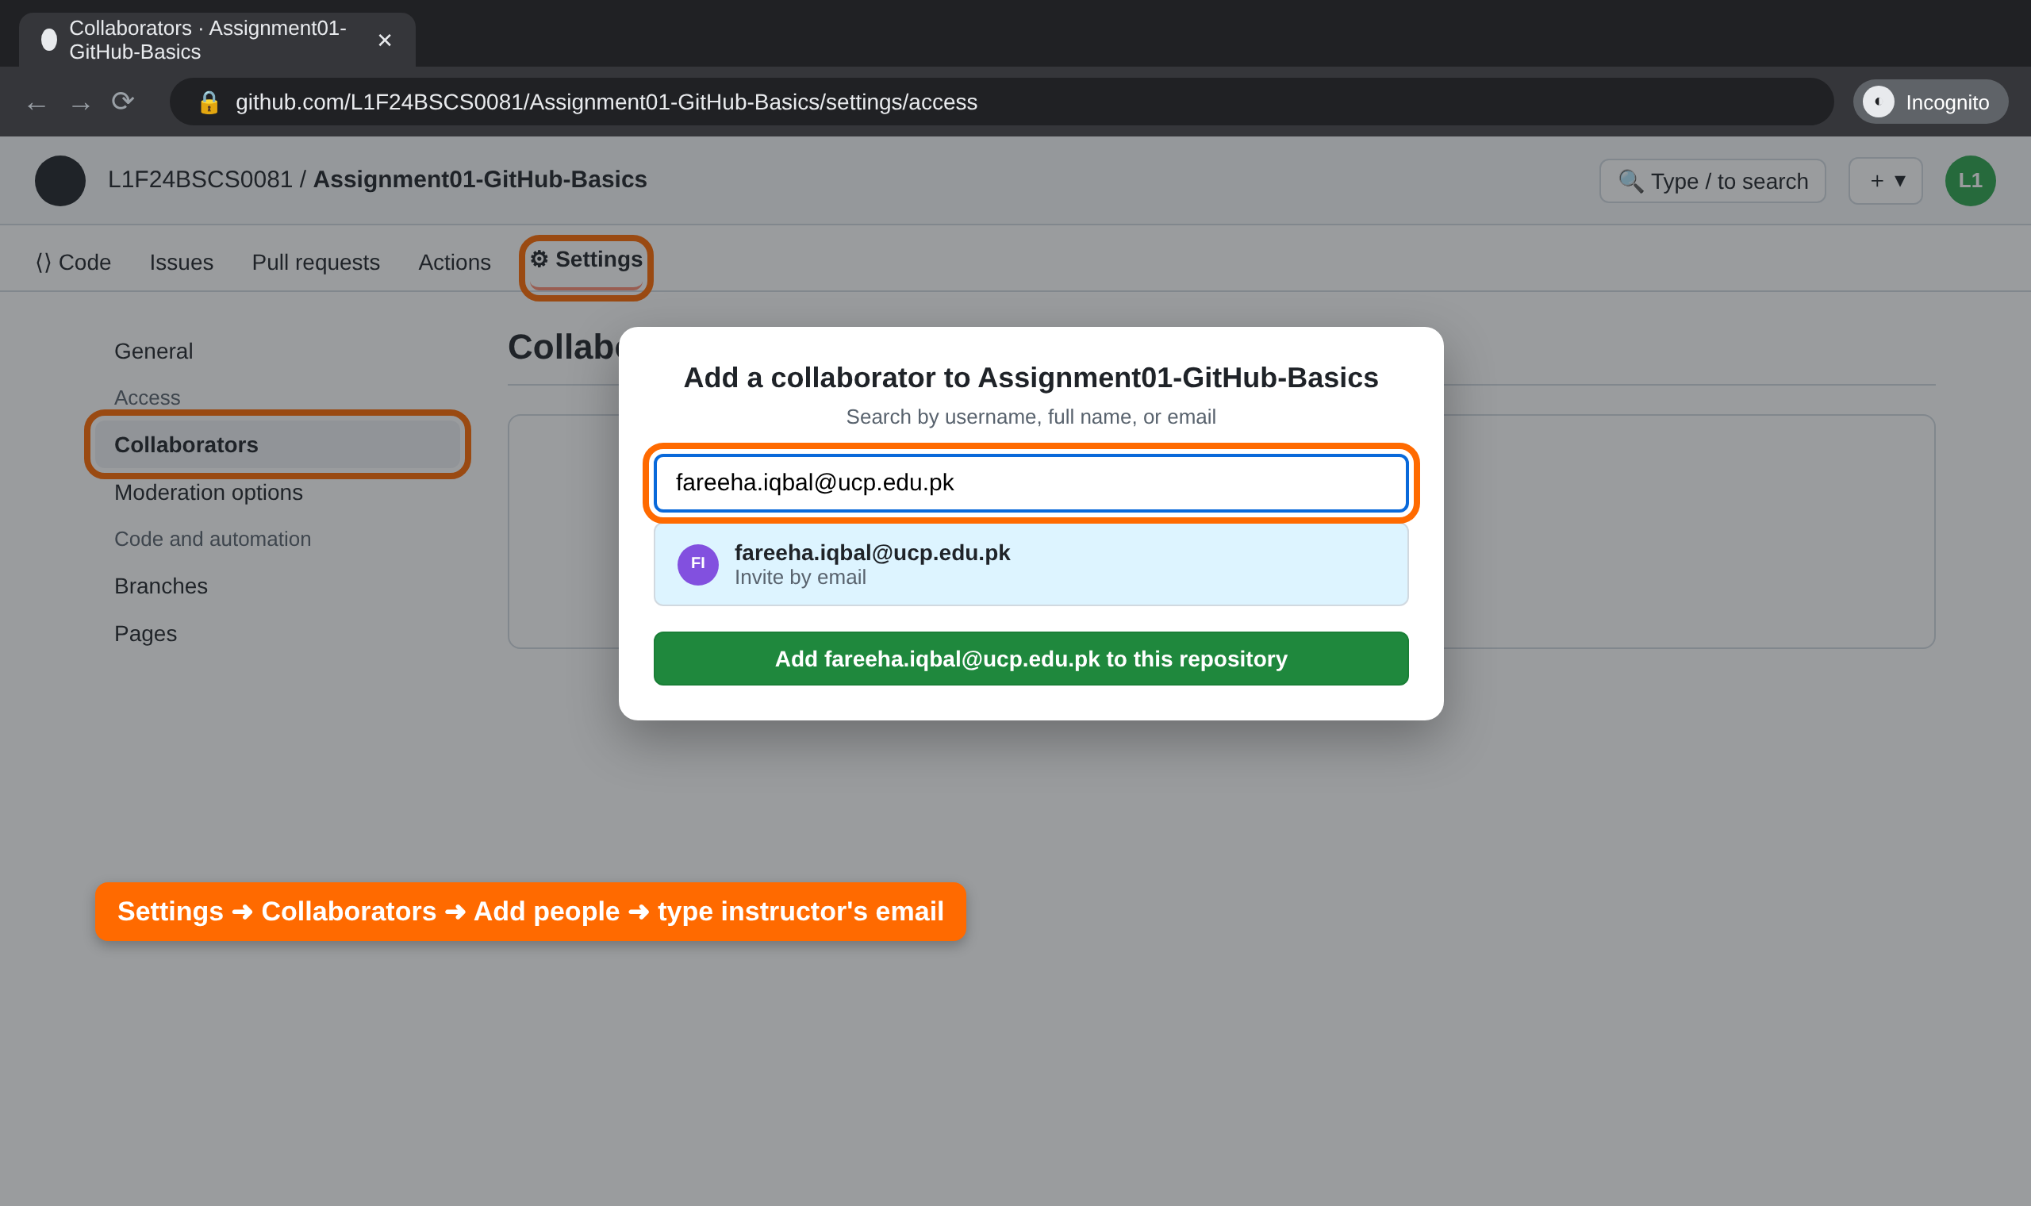
STEP 8
Share your repository with your instructor
1
Open your repository and click the ⚙ Settings tab.
2
In the left sidebar under Access, click Collaborators, then Add people.
3
Type the instructor's email: fareeha.iqbal@ucp.edu.pk
4
Select it and click Add … to this repository. Status shows “Pending Invite” until accepted.
Type the email exactly — a typo sends the invite to the wrong person.
Illustrative mock-up — the real GitHub screens may look slightly different.
Notes:
Invitations to fareeha.iqbal@ucp.edu.pk arrive by email and must be accepted by the instructor; GitHub invitations expire after 7 days, so accept them within the first week. Students see 'Pending Invite' until then — that still counts as shared. Students screenshot this Collaborators page for page 3 of their portal submission PDF.

Slide 20
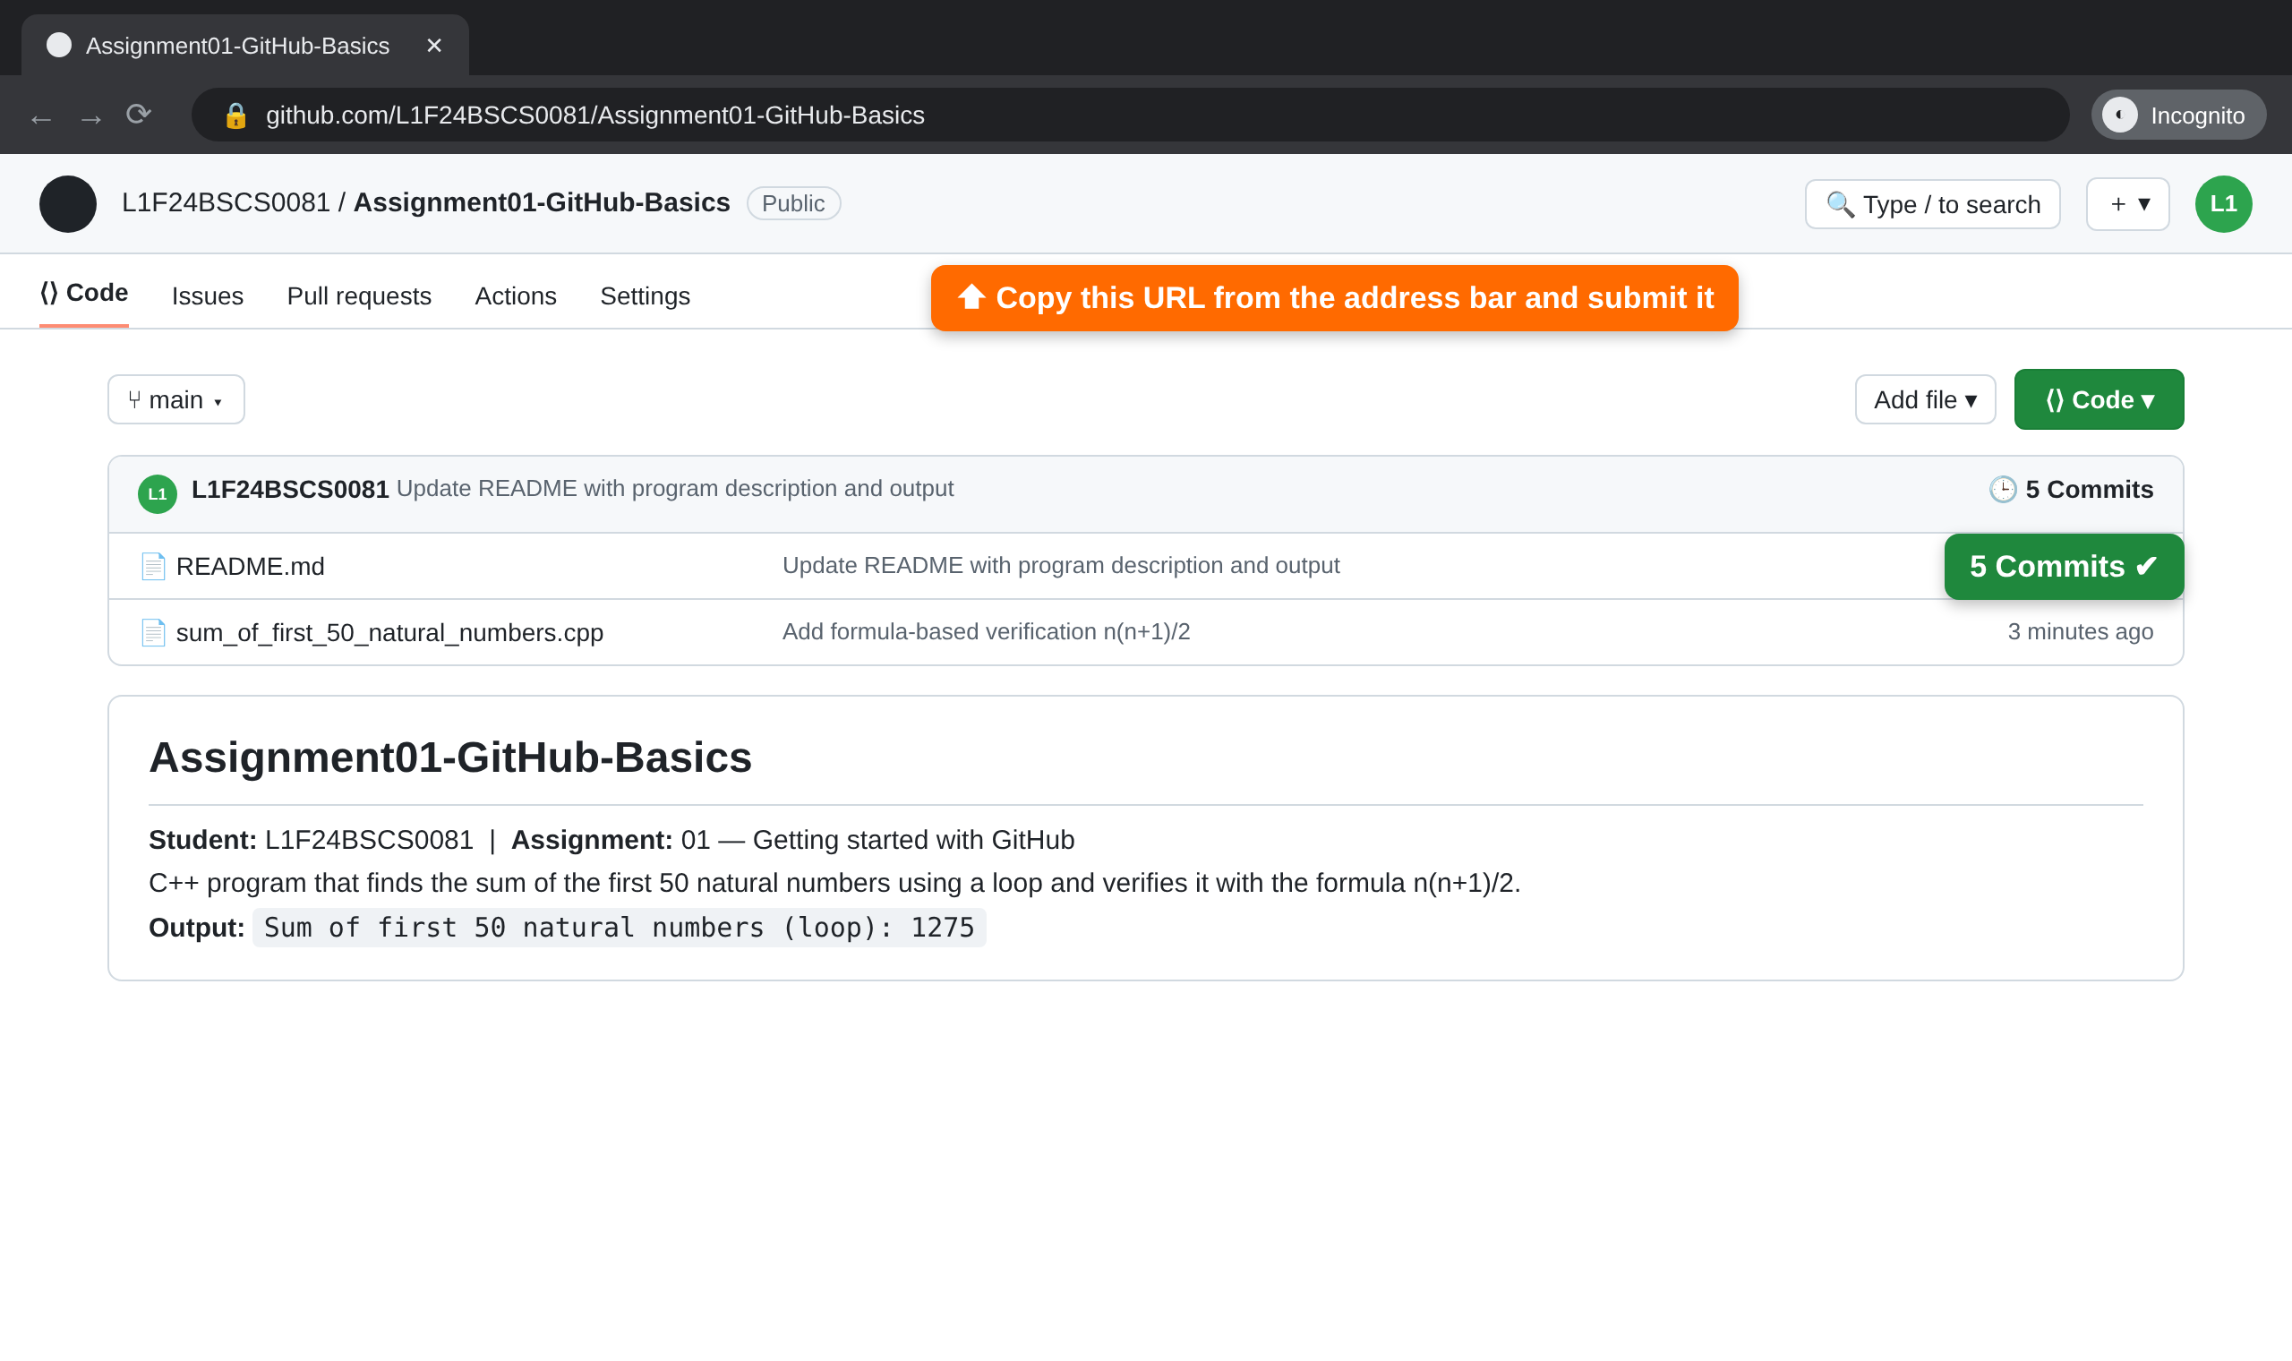
STEP 9
Final result — check before you submit
Your repository link will look like this:
https://github.com/
L1F24BSCS0081/Assignment01-GitHub-Basics
Before submitting, confirm:
Username is your Reg No
Repository is Public
.cpp file has a proper name
At least 5 commits are shown
README describes the program
Instructor invited as collaborator
Illustrative mock-up — the real GitHub screens may look slightly different.

Slide 21
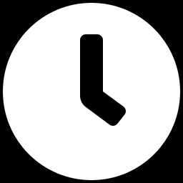
STEP 10
Submit your PDF on the portal
1
Make ONE PDF named with your Reg No: L1F24BSCS0081_Assignment01.pdf
2
Page 1 — your repository link (copied from the address bar).
Page 1 · Repository link
Page 2 · Commit history
Page 3 · Collaborator invite
3
Page 2 — screenshot of your Commits page showing at least 5 commits.
Deadline rules
4
Page 3 — screenshot of Settings → Collaborators showing the instructor invited.
The portal upload time is your official submission time.
Only commits made before the deadline will be marked.
No PDF on the portal = not submitted, even if your GitHub work is complete.
Late submissions are handled as per course policy.
5
Upload the PDF on the course portal before the deadline.
Notes:
The portal's submission list is the record of who has submitted and who met the deadline. GitHub commit times (shown on the Commits page) let you confirm the work itself was done before the deadline.

Slide 22
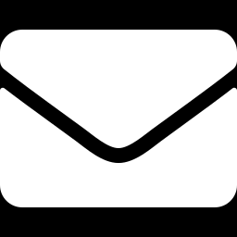
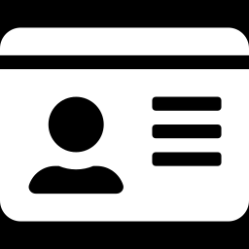
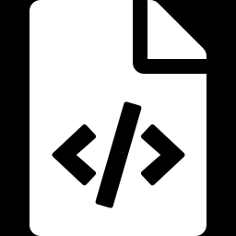
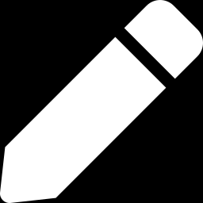
Troubleshooting
No verification email
Username already taken
Someone else's account opened
Wait 2 minutes, check Spam / Promotions, click Resend. Check the email address is spelled correctly.
Tell your instructor. Do not invent a different username.
Close the window, open a fresh Incognito window, and sign in with your own details.
Wrong file uploaded
Typo in a file name
Forgot password
Open the file → ⋯ menu → Delete file (this is also a commit), then upload the correct one.
Edit the file and change the name in the name box at the top, then commit.
On the sign-in page click “Forgot password?” and reset it via your email.

Slide 23
For Queries:
Email me at fareeha.iqbal@ucp.edu.pk
Office Hours:
Wednesday : 11:00 AM – 1:00 PM
Friday : 10:00 AM -12:30 PM
Office Venue:
A Building F301-Cabin 4

